Slide 1
Home Credit Default Risk
Ngai Nok Yiu, Cheung Hang Yee

Slide 2
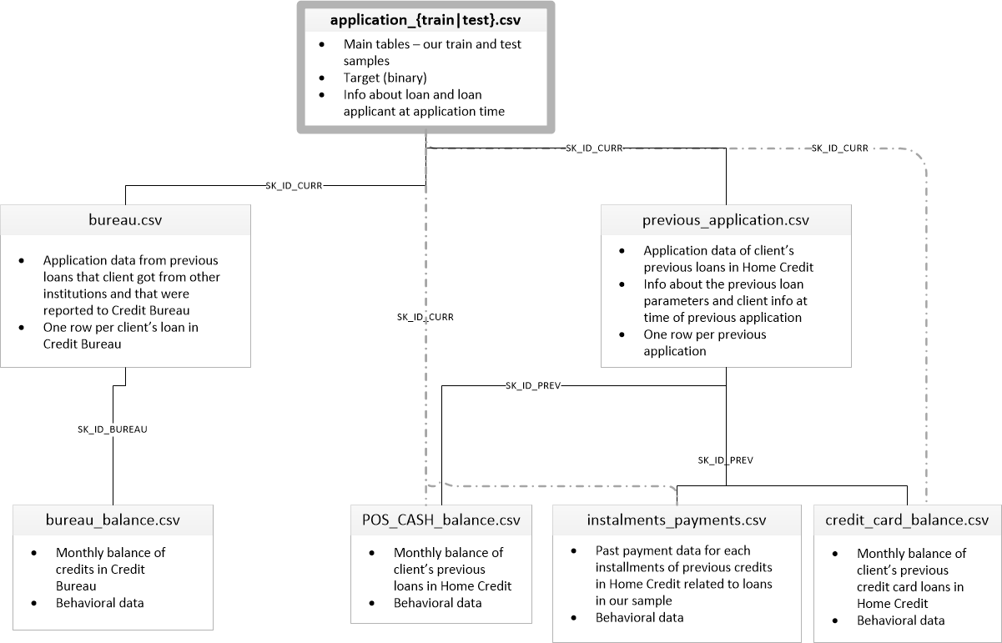
Data Structure
source : https://www.kaggle.com/willkoehrsen/start-here-a-gentle-introduction

Slide 3
Preprocessing
Previous Loan
Summary of Previous Loan
Applicant
Applicant
Previous Loan
Numeric:
'count', 'mean', 'max', 'min', 'sum'
Categorical:
'sum', 'mean'
Previous Loan

Slide 4
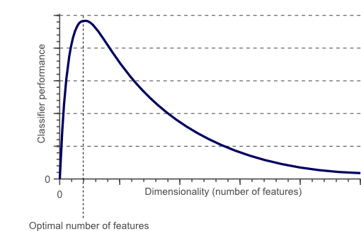
Feature Selection
Over 1000 columns in the joint table
Curse of dimensionality

Slide 5
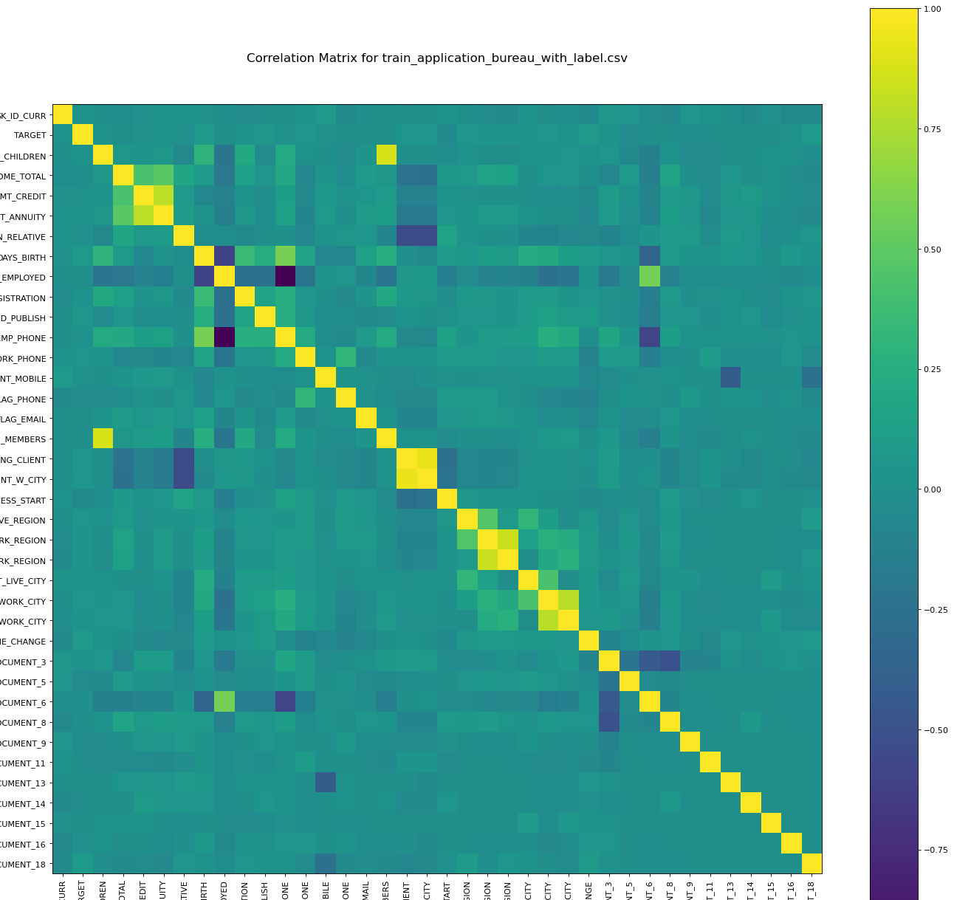
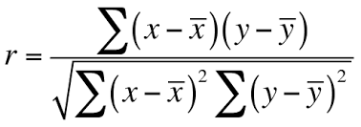
Pairwise Correlation
Compute pairwise correlation of columns
Pearson Correlation
Remove highly correlated (collinear) features

Slide 6
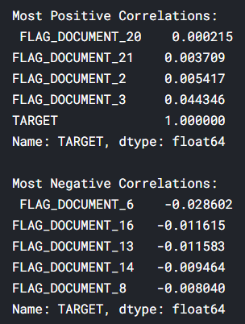
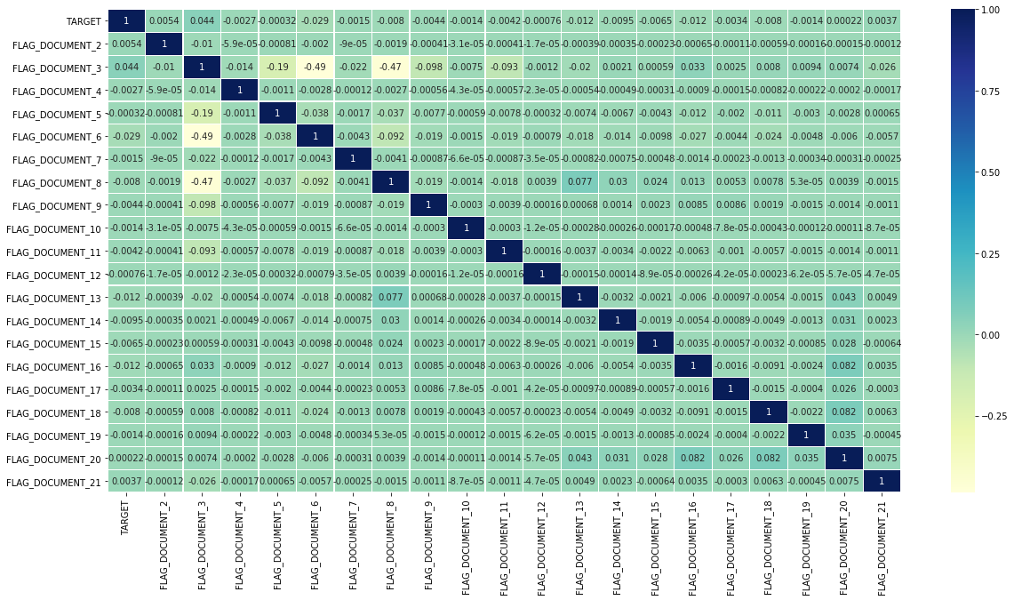
TARGET Correlation
Use the FLAG_DOCUMENT as an example:

Slide 7
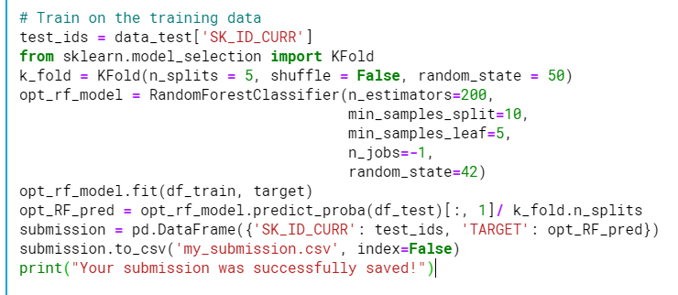
Random Forest

Slide 8
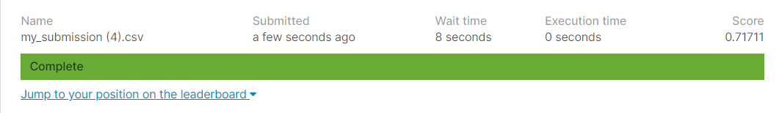
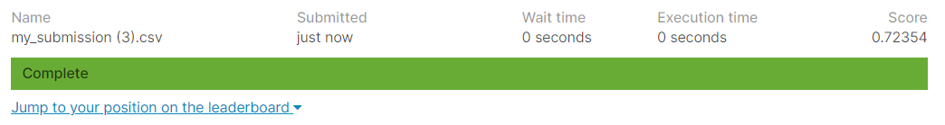
TARGET Correlation
Prediction without using Correlation
Prediction without using Correlation

Slide 9
Correlation method
Only consider linear relationship

Slide 10
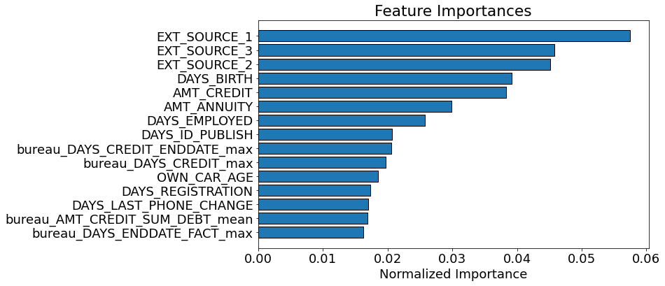
Embedded method
Feature importance from fitting the training data to LGBMClassifier

Slide 11
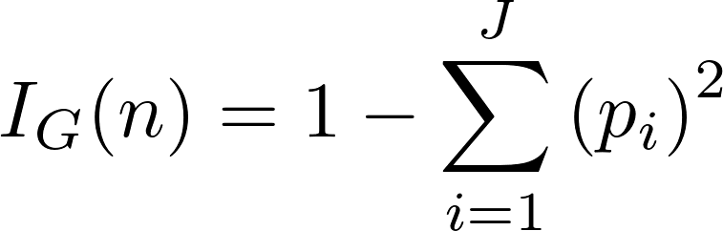
LGBMClassifier - feature importance
How much each feature decreases the weighted impurity in a tree.
The Gini Impurity of a node is the probability that a randomly chosen sample in a node would be incorrectly labeled if it was labeled by the distribution of samples in the node.

Slide 12
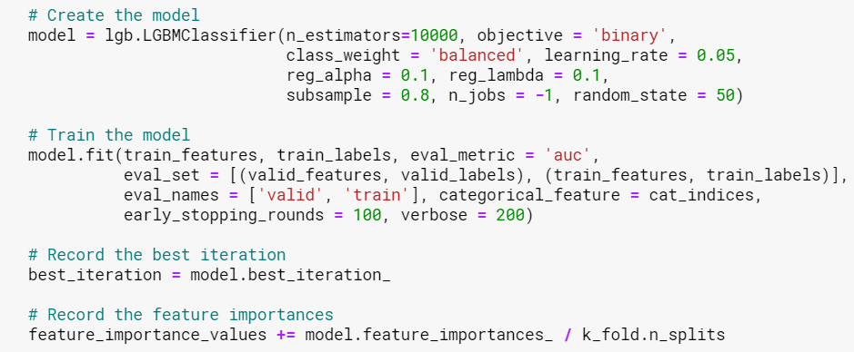
Averaging
10-fold cv
Average all feature importance, remove 0 importance features

Slide 13
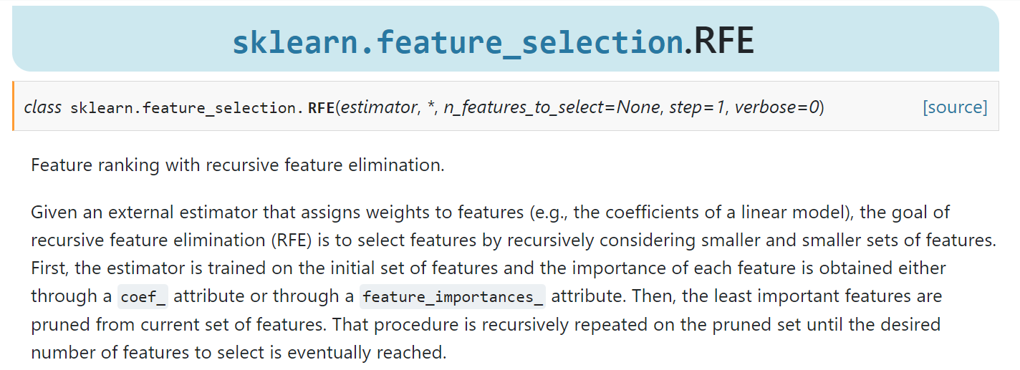
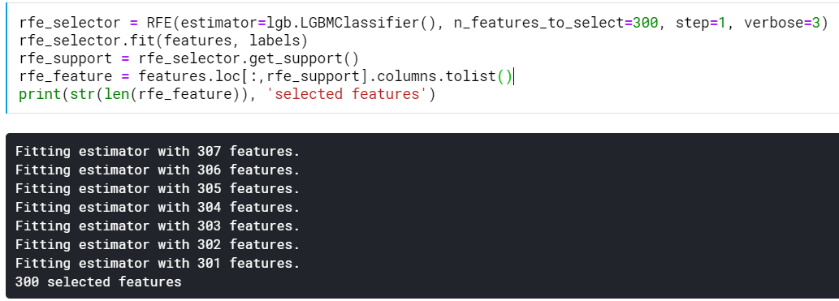
Recursive

Slide 14
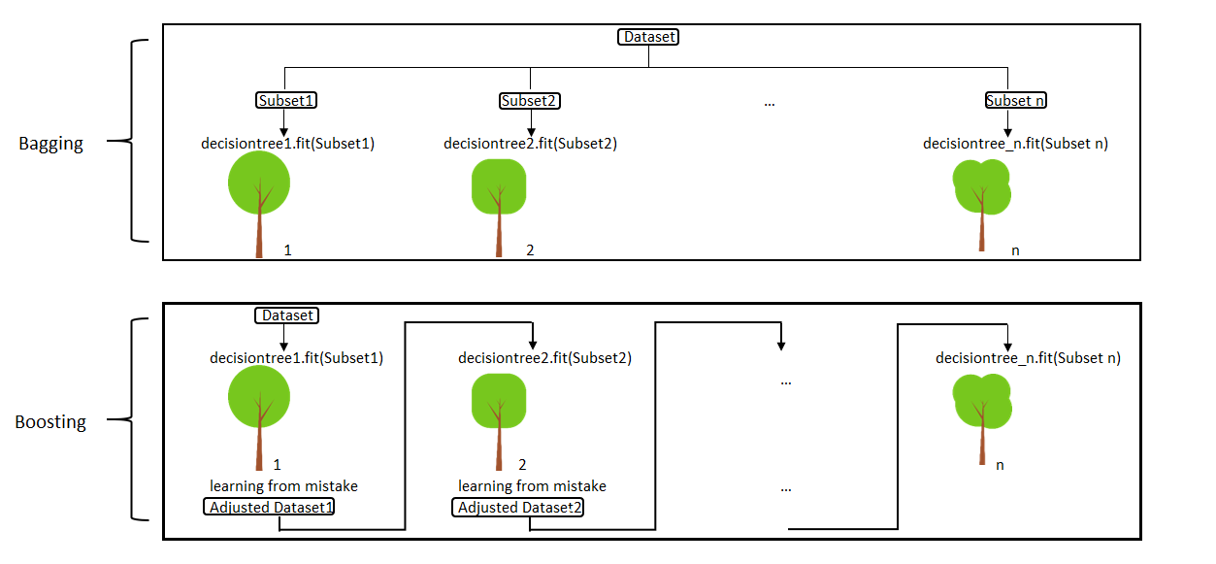
LGBMClassifier vs Random Forest
Notes:
https://medium.com/@aravanshad/gradient-boosting-versus-random-forest-cfa3fa8f0d80

Slide 15
LGBMClassifier vs Random Forest
How trees are built:
Gradient Boosting: GBT build trees one at a time, where each new tree helps to correct errors made by previously trained tree.
Random Forest: RFs train each tree independently, using a random sample of the data.
Combining results:
random forests combine results at the end of the process (by averaging or "majority rules") while gradient boosting combines results along the way.
Notes:
https://medium.com/@aravanshad/gradient-boosting-versus-random-forest-cfa3fa8f0d80

Slide 16
LGBMClassifier vs Random Forest
Weaknesses of the model
-GBMs are more sensitive to overfitting if the data is noisy.
-Training generally takes longer because of the fact that trees are built sequentially.
-The main limitation of the Random Forests algorithm is that a large number of trees may make the algorithm slow for real-time prediction.
Source:https://medium.com/@aravanshad/gradient-boosting-versus-random-forest-cfa3fa8f0d80

Slide 17
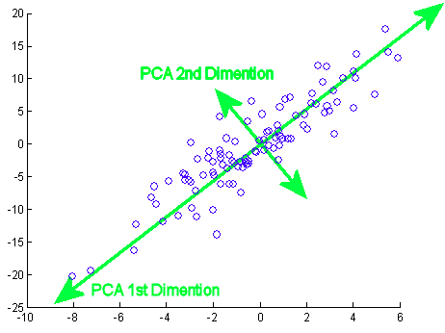
PCA - not applicable
PCA is a rotation of data from one coordinate system to another.
Works for continuous variables
The only way PCA is a valid method of feature selection is if the most important variables are the ones that happen to have the most variation in them.
Source: https://towardsdatascience.com/pca-is-not-feature-selection-3344fb764ae6

Slide 18


Slide 19
MATH 4995 Mini-Project 2: Home Credit Default Risk
Ngai Nok Yiu (20510180), c (20514796)
Feature Selection - univariate selection
1. Introduction
We calculate linear correlation each variable in the training table and then remove the highly correlated variables to remove collinearity.
A total of 71 columns is removed. Some examples of the removed columns are LIVINGAREA_AVG and LIVINGAPARTMENTS_AVG.
We fit this training data to a light gradient boosting model and get a score of 0.742
Home Credit default risk problem aims to predict whether or not an applicant will be able to repay a loan based on previous loan and application information. This is a supervised 2-class-classification problem. Our focus in this project is to explore different feature selection method, to save computation power, we use application and bureau data only.
Feature Selection - Random Forest
The third method we test for feature selection is using the feature importance generated in the Random Forest model, by using Mean decrease impurity. We compare the difference between removing the useless feature and the using full feature . The score the using the full feature is 0.717 and the score removing the useless feature is 0.723.
2. Feature Engineering
First, we aggregate the numeric loan information made by each customer in in bureau and bureau_balance with count,mean, max, min and sum. For the categorical columns, we aggregate the value with sum and mean.
Second, Bureau and bureau_balance is merged together on 'SK_ID_BUREAU'. Then this joint table is merged to application so that one row in the final joint table represent each loan made by each customer. This final joint table contains 308 columns.
Fitting these columns to a light gradient boosting model and get a score of 0.75686.
The next step is to do feature selection so that we can save computation power and improve the generalization of the model.
Correlation Matrix plot of training data
6. Conclusion
Feature Selection - LGB model
The disadvantage of using univariate selection is that it can only consider linear relationship between variables while in real world, the relationship are often more complicated. Light gradient boosting model can handle null value thus reduce the effect on imputing a value to fillna.
The second method we test for feature selection is using the feature importance generated in the light gradient boosting model. We fit the training data to the model for 10 iteration and then calculate the average feature importance. There are 77 features with 0.0 importance. Some examples are FLAG_MOBIL which has the same value in the whole column.
This method get a score of 0.75717. The following is the feature importance graph.
7. Contribution
Feature Engineering, Feature selection: Ngai Nok Yiu
Feature selection: Cheung Hang Yee

